Slide 1
SOLID WASTE RECYCLING INDUSTRY

Slide 2
GROUP 1
MAJ. BAZLUR RASHID 201714008
MASRUR HASAN MAHIN 201714027
MD. ARIFUL ISLAM TAREK 201714030
MD. RAQIBUR RAHMAN 201714040
MD. ISMAIL HOSSIAN 201514027

Slide 3
VISITED ORGANIZATION

Slide 4
DHAKA NORTH CITY CORPORATION
- CDRE. M.A. RAZZAK , HEAD OF WASTE DISPOSAL
THE BENGAL GLASS WORKS LTD.
- ZAKIR HOSSAIN, AGM-SUPPLY CHAIN

Slide 5
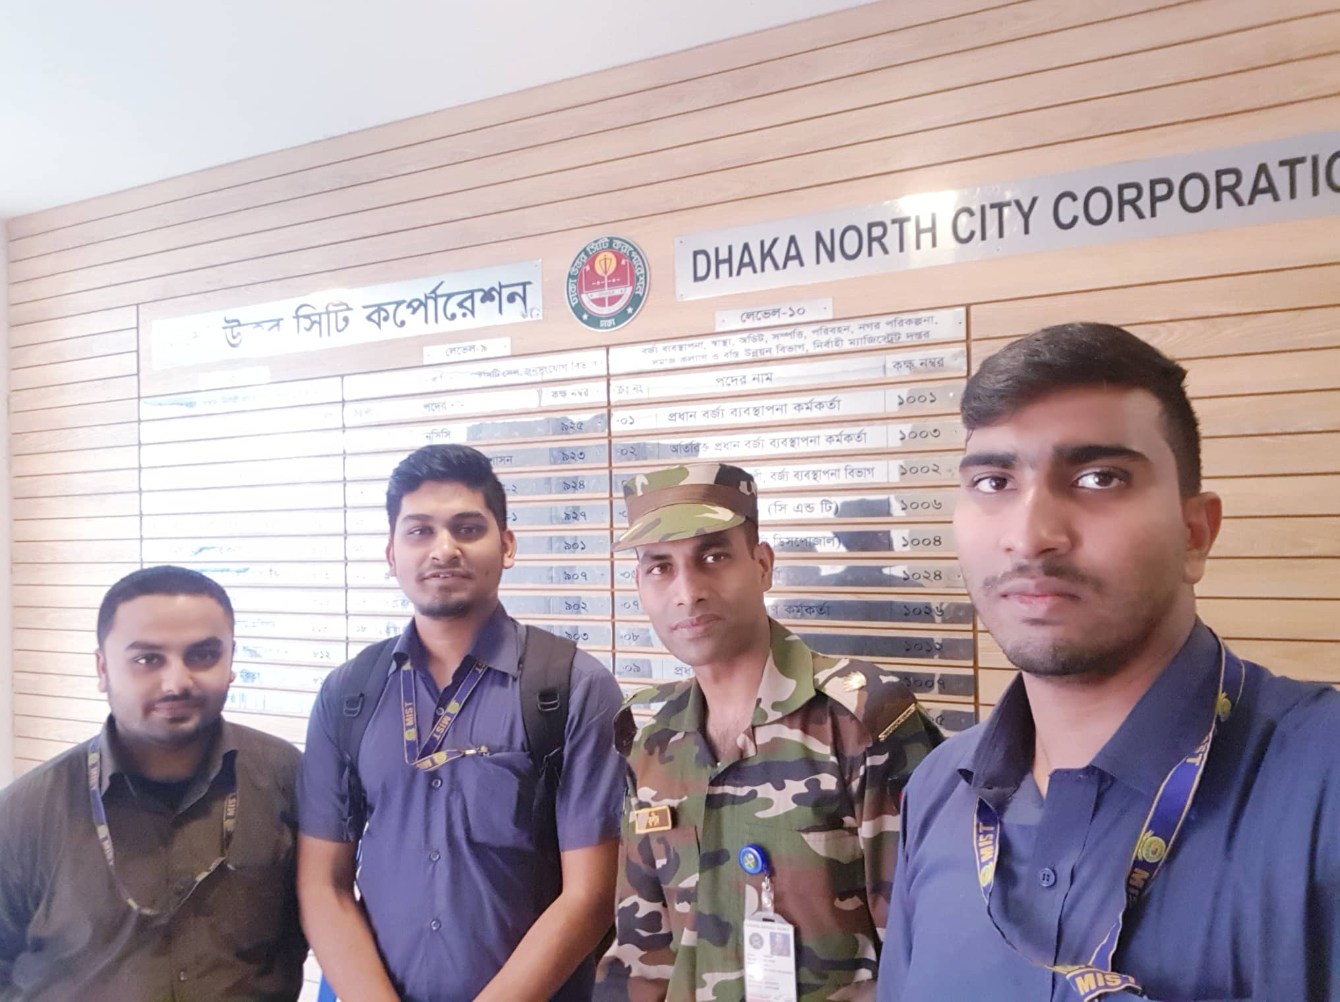
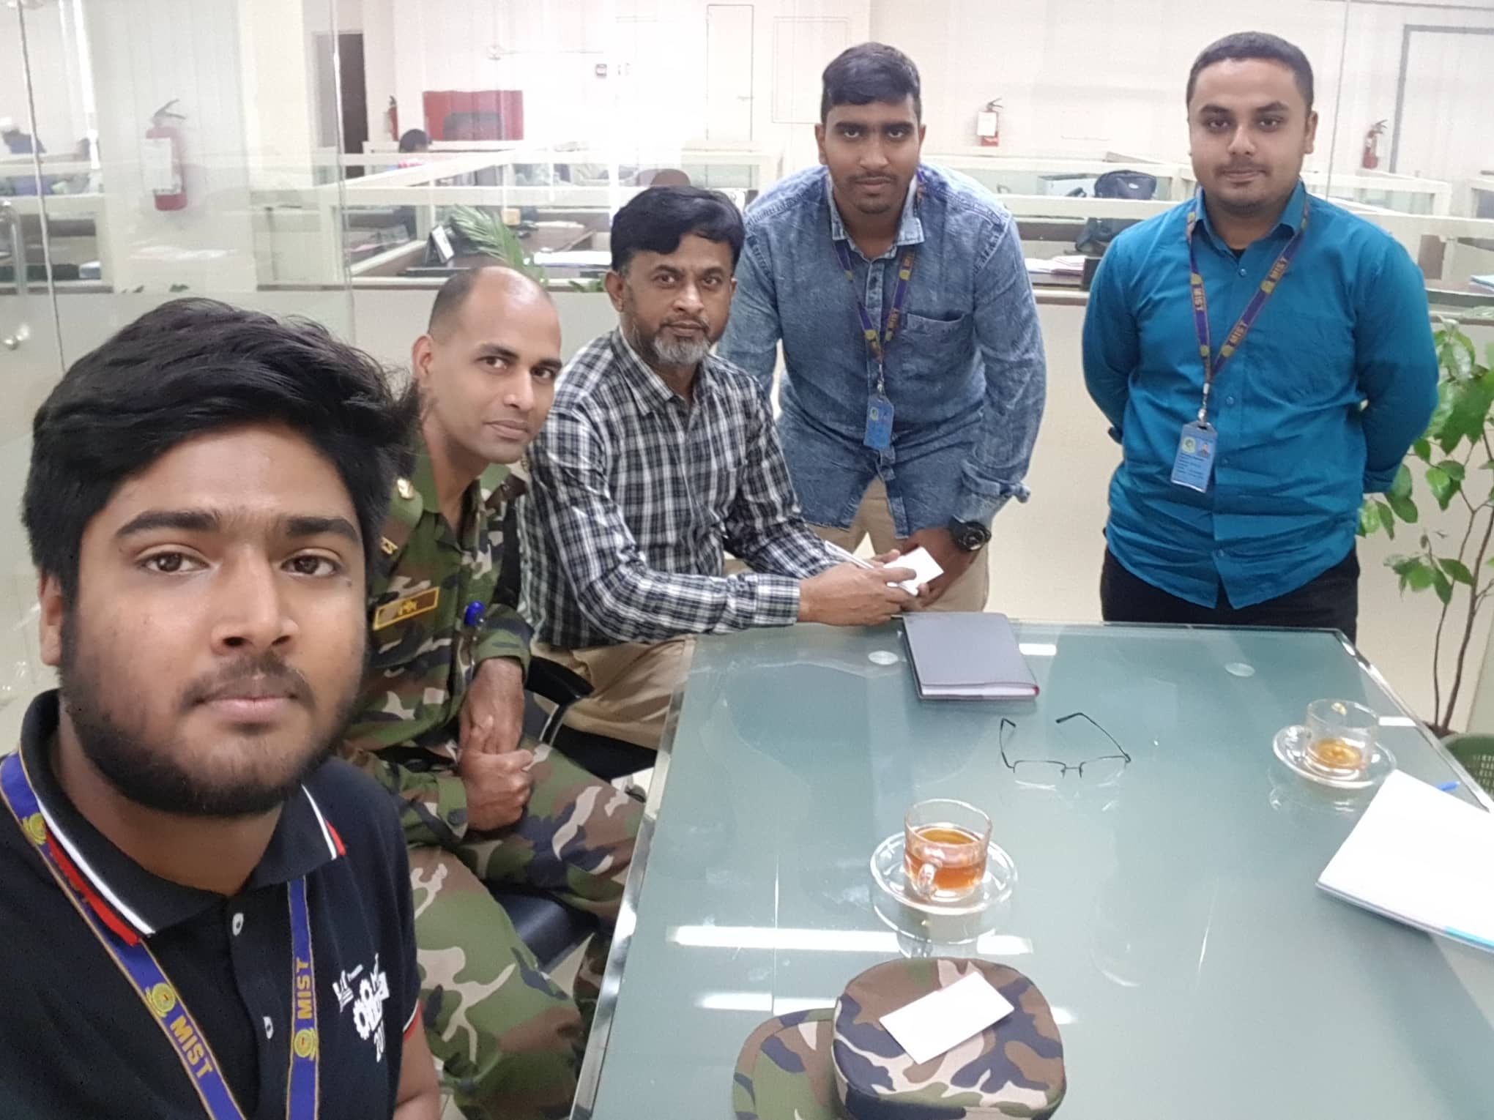

Slide 6
SCOPE
TYPES OF ORGANIZATION
TYPES OF WASTE
ORGANIZATION OVERVIEW
- SUPPLIER
- MANUFACTURER
- CONSUMER

Slide 7
TYPES OF ORGANIZATION
GOVERNMENT
- MUNICIPALITY
NON GOVERNMENT
- THE BENGAL GLASS WORKS LTD.
- GEMS GLASS FACTORY
- RENATA
- OTOBA TYRE INDUSTRIES
- PYROLYSIS FUEL INDUSTRIES

Slide 8
TYPES OF WASTE
GOVERNMANT
- FOOD & VEGETABLE
- CLOTHES - METAL
- WOOD
NON GOVERNMANT
- IRON
- GLASS
- PLASTIC
- PAPER

Slide 9
ORGANIZATION OVERVIEW
SUPPLIER
- COLLECTION
- AGNETS
- TRANSPORT

Slide 10
ORGANIZATION OVERVIEW
MANUFACTURER
- SUPPLIER
- EMPLOYEES
- PRODUCTION
- TURN OVER
- CONSUMERS

Slide 11
ORGANIZATION OVERVIEW
CONSUMER
1. INDIRECT
- DAILY LIFE USERS
2. DIRECT
- COMPANIES
- LOCAL DEALERS

Slide 12

FRONT END
PHP

Slide 13
THANK YOU

